Slide 1
Impacted Canine Tooth and its Management

Slide 2
Introduction
Maxillary canine
Classification of canine impaction
Reason for canine Impaction
Diagnosis
Treatment options
Methods of Creating Space
Attachments For canine
Methodolgy of Approach
Surgical Exposure of impacted canine
Impacted tooth and Periodontium
Retention
Complication of untreated impacted canine
Time to extract canine
Conclusion

Slide 3
Introduction
Impacted tooth is defined as tooth whose roots are 2/3rd or fully developed but nevertheless expected to erupt.
Mandibular third molar -- Maxillary canine -- mandibular second premolar.
In maxillary canine impaction ,palatal canine impaction is more common than buccal canine impaction.{Jacoby 3:1}.
Females affected more than males.
Oliver 1989 showed Asians affected from buccally impacted canines more frequently than from palatally impacted canines.

Slide 4
Maxillary canine
Development of canine : It develops at 4 – 5 months of age between the roots of decidious Ist molar.
Calcification of canine : It begins to calcify around 12 months of age.
Eruption of canine : Its left behind the roots of deciduous molar , allowing development of the first premolar between the deciduous molar roots. At this stage the permanent canine is located immediately above both the first premolar and the first deciduous molar.

Slide 5
As the deciduous teeth erupts towards the occlusal plane, the permanent incisor and canine crypts migrate forward in the jaws at a greater rate than the forward movement of the deciduous teeth themselves .
Around 6-7 years of age canine calcification will be completed .
At the age of 7 years, the canine crown is medial to the root of its deciduous Predecessor ,and there is a vertical overlap of approxiamtely 3mm.
Williams, 1981 showed the positional changes between 8 and 10 years of age need careful observation for detection of potential impaction. During this stage of development the canine normally migrates buccally from a position lingual to the root apex of the deciduous precursor. However, some canines do not make the transition from the palatal to the buccal side of the dental arch and

Slide 6
remain palatally unerupted.
With sufficient increase in the size of the subnasal area, the maxillary canine normally moves downward, forward and laterally away from the root end of the lateral incisor.
Between 8 and 12 years of age, the ‘uglyduckling’stage, there is insufficient space at the apical base to permit the axis of the lateral incisor to shift into the more erect alignment of young adulthood until the canine approaches its place in the dental arch .
In the final phase of eruption, canines drive their way between the lateral incisors and first premolars,forcing these teeth to become more upright. Thus the maxillary canine follows a longer, and more tortuous path of eruption than any other tooth

Slide 7
Classification of canine impaction:
Class I:
Impacted cuspids located in palate.
a) Horizontal
b) Vertical
c) SemiVertical
Class II:
Impacted cuspids located in Labial or buccal surface
of maxilla
a) Horizontal
b) Vertical
c) SemiVertical

Slide 8
Class III:
Impacted cuspids located in palatine and maxillary bone e.g.crown is on the palate and root passes through the root of the adjacent teeth and ends in the labial or buccal surface of maxilla.
Class IV:
Impacted cuspids located in the alveolar process,usually vertically between incisor and first bicuspids

Slide 9
Reason for canine Impaction
Becker Concepts :
Becker (1984) hypothesized two processes in the palatal impaction of the maxillary canine:
I) Absence of initial early guidance from an anomalous lateral incisor.
II) Failure of buccal movement of the canine at an unspecified age .
MC Bridge Concept
Canine formed at high in the anterior wall at antrum, below the floor of orbit, long tortous path of eruption.

Slide 10
Moyers Concept: Summarized by Bishara
A)Primary cause:
1) Trauma to decidious tooth bud
2) Rate of Resorption of decidious tooth
3) Availability of space in the arch
4) Disturbance in tooth Eruption Sequence
5) Rotation of tooth buds
6) Canine Erupt in Cleft area in Person with Cleft
7) Premature root Closure
B)Secondary cause:
1) Abnormal muscle pressure
2) Febrile diseases
3) Endocrine disturbances
4) Vitamin D deficency.

Slide 11
Berger Concept :{Systemic cause of impaction}
1) Malnutrition
2) Tuberculosis
3) Syphilis
4) Rickets
5) Anemia
6) Progeria
7) Syndromes:
a) Cleidocranial dysplasia
b) Achondraplasia
c) Down syndrome

Slide 12
Vonder Heydt Concept
Total arch length of permanent teeth is initially established very early in life at the time of eruption of first permanent molars. Canine is larger and later erupting and considering like a musical chair situation it may get impacted.
Guidance Theory - Miller
Normal Eruption: Canine usually have a more mesial development path,which is guided downwards apparently along the distal aspect of the lateral incisor roots.

Slide 13
First stage Impaction:If there is a loss of guidances due to missinig lateral incisors or late developing laterals, canine will have mesial and palatal path of eruption.In this event there is no vertical movement of canine into the alveolar process,results in more horizontal impaction.
First stage impaction and secondary correction:Once it reached the palatal alveolar process,canine is redirected to more favorable path of eruption.
Second stage Impaction:Self correction is prevented by, late developing lateral incisors (peg laterals) which redeflect the tooth further palatally
Second stage Impaction and secondary correction:Extraction of deciduous canine or even extraction of lateral incisors leads to spontaneous eruption of the impacted tooth.

Slide 14
Peck and Peck Concept:
1) Occurrence of other dental anomalies:
Palatally impacted canine is an inherited trait occurs in combination with tooth agenesis,tooth size reduction,supernumery tooth and other ectopically positioned tooth.
2) Bilaterally occuring Phenomenon (17%)
3) Females affected more than males (1:3.2)
4) Familial occurence
So they concluded palatally impacted canine as dental anomaly as GENETIC ORIGIN.

Slide 15
DIAGNOSIS
CLINICAL EVALUATION:
1) Prolonged retention of deciduous canine
2) Delayed eruption of permanent canine
3) Presence of palatal bulge
4) Absence of labial canine bulge
5) Delayed eruption, persistent distal tipping and
migration of lateral incisors.

Slide 16
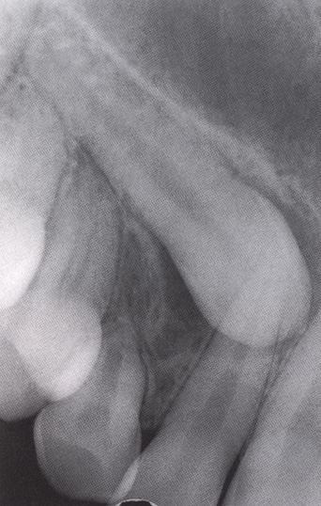
RADIOGRAPHIC EVALUATION
I) INTRA-ORAL RADIOGRAPH:
1) IOPA: The first, simplest and most
informative X-ray film is the periapical view.
Advantages;
1) Root development,paternn and integrity
2) Crown resorption
3) Root resorption of adjacent tooth
4) Minimun of surrounding tissue is exposed which
increase accuracy and resolution.
5) Minimal radiation exposure

Slide 17
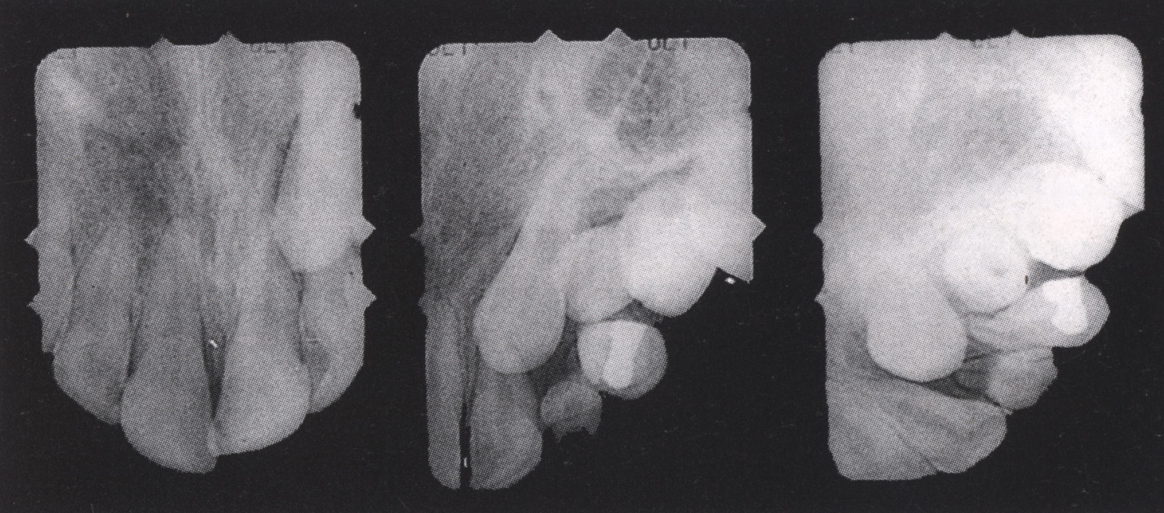
Disadvantage
1) Periapical fim is a two dimensional representation which gives no information regarding buccal lingual plane
2) Overlapping structures cannot be differentiated as whether tooth is lingual or buccal.
2) Tube shift technique or Clarke technique (PARALLAX METHOD)

Slide 18
This method was introduced by clark in 1909,later refined by Richard in 1948.It is based on binocular principle where two periapical views of same object are taken at different angles will depict the position of tooth in buccolingual position.
Procedure: The first film was taken in one angulation .Second film is placed in identical position but X-ray tube is shifted mesially or distally around the arch,but held at the same angle at the vertical plane and directed at the mesially or distally adjacent tooth
a) If the object is moves in the same directions, it is lingually positioned.
b) If the object moves in opposite direction, it bucally located.

Slide 19
Disadvantage: In cases when canine is highly placed, and periapical film shows no superimposition of canine with the roots of erupted tooth or when superimposition is only in the periapical region the result may be misleading.
3) BUCCAL OBJECT RULE TECHNIQUE
If the vertical angulation of cone is changed approximately 20⁰ in two succesive films.
a) Buccal will move in the direction opposite to the source of radiation.
b) Lingual object will move in the same direction as source of radiation.

Slide 20
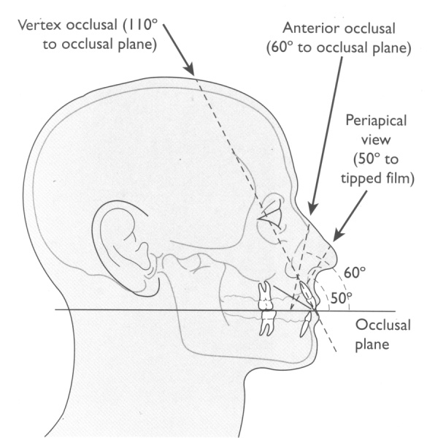
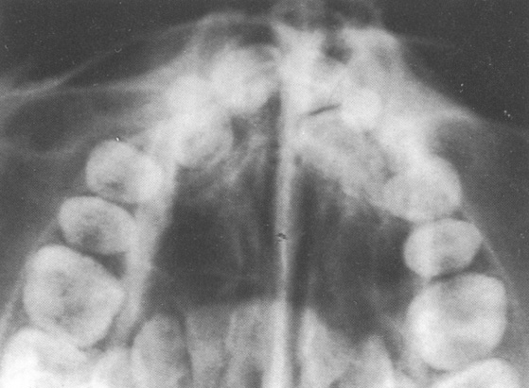
4) OCCLUSAL RADIOGRAPH(TRUE OCCLUSAL OR VERTEX OCCLUSAL)
In this view the central ray of X-ray beam runs parallel to long axis of central incisors.Exposure is done through the vertex i.e 110º to the occlusal plane.
when the radiograph is viewed the anteriors are seen as small tiny concentric circles.

Slide 21
If the impacted tooth is not parallel to neighbouring tooth, ,depend on angulation of long axis of the tooth it will be elliptical or oblique in cross section.
If tooth is horizontal its full length will be seen.
EXRAORAL RADIOGRAPH
1) Lateral cephalograph:
This represent a true lateral view of the skull which defines the anteroposterior i.e mesiodistal position and vertical position of the tooth.

Slide 22
2)PosteroAnterior view :
This represent the vertical position of the tooth. The buccolingual tilt of the tooth is also clearly visible.This view also shows whether the root apex is in line of arch and how far the crown is deflected in palatal direction .
3) OPG: (Erickson1988):
Canine tooth development: Resorption of lateral incisor roots ,has a direct relation with the development of canine.
Position of Canine: More the mesial position of canine in OPG, increased chance for resorption of laterals incisors and palatal impaction.

Slide 23
Inclination of Canine: If the inclination of canine to midline is more than 25° , more chance for resorption of lateral incisors and less favorable for the canine to reach occlusal plane without traction.
Using all these information, it is easy to build up a three dimensional picture of the exact position and angulation of the impacted tooth and to define type of tooth movement to bring the tooth in to alignment.
CT Scanning:
Charles and Frank in 2003, showed all the above mentioned method are 2 dimensional so it is difficult to appreciate the position of canine.

Slide 24
To quantify the position of canine, a Three dimensional image like CT should be used.
CT Scanning is a method in which clear radiograph taken at graduated depth in any part of the human body. By viewing serial radiograph slices of the maxilla, the relationship of the impacted tooth to adjacent teeth in all the three plane of space can be accurately assessed.
Disadvantage:
1) Expensive.
2) Increased Radiation Exposure than any other method

Slide 25
TREATMENT OPTIONS
1950---1960
During 1950s orthodontist themselves reffered patients to oral surgeons,they decide the treatment for the tooth
1) They provide optimal enviroment for normal and unhinder eruption of the impacted tooth
2) If the tooth is little deep,they place white head varnish to protect the wound during the healing phase and to prevent rehealing of the tissue over the tooth.
3) If the tooth is very deep, extracting the tooth and prosthesis.

Slide 26
1961-1980
In 1968 Moss showed Reimplantion of canine in its position after extracting deciduous canine.
In 1971 Johnston and Lewis showed surgical uncovering of maxillary canine allowing then to eruption spontaneously to a certain degree, followed by buccal traction by means of edge wise appliance.
In 1975 vander Heydt surgical uncovering of maxillary canine allowing then to erupt spontaneously to a certain degree followed by later application of begg technique.
In 1979 Becker and Ziberman palatal traction applied from TPA or lingual arch.

Slide 27
In 1979 Jacoby showed palatal traction by means of ballista spring attached to the buccal surface of posterior teeth with TPA as anchorage, produces a comfortable and controlled movement of uncovered impacted canines. This avoids impinging of canine on roots of lateral incisors reduce the surgical trauma, ensures anchorage and preserves esthetics to the patient.
In 1980 Aitman and Spector showed in cases with difficulty in bringing canine to occlusion, extract the tooth and substitute by premolar
After 1980s treatment plan was done accordingly to the type and level of impaction

Slide 28
Methods of Creating Space
One of the primary objective of orthodontic treatment of impacted canine is the creation of space in the dental arch for the impacted tooth alignment.
A) Existing incisor space:
Becker showed Incisor spacing was due to failure of completion of ugly duckling stage of development .During final stage these existing space will be closed by mesial movement of lateral incisor.
B) Maintaing the Existing space:
Headgear is recommended to prevent the mesial movement of molar and to utilize leeway space.Correcting the rotation of molar and premolar will also adds space.

Slide 29
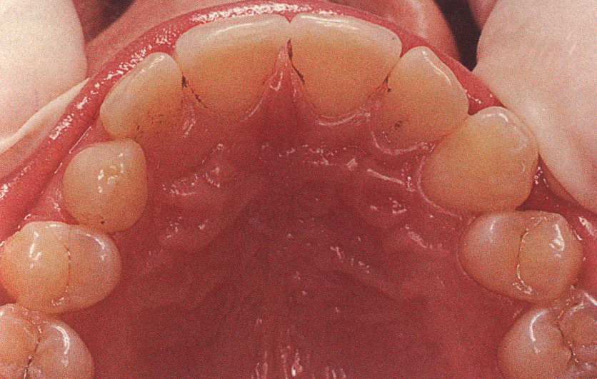
C) Improving Archform:
The achievement of good archform is an
important initial goal in the maxillary arch in
non extraction cases. Maxillary canine erupt
more buccally to deciduous canine and
slightly buccally to premolar and lateral incisors.So improving archform after extraction of deciduous canine will adds 2-3 mm of space.
D) Increasing ArchLength:
In mild crowding cases distalization of molar is recommended which increases the arch length.

Slide 30
But in some cases this space is not sufficient to guide permanent canine in to occlusion.In these cases extaction is necessary.
E ) Extraction as a mean of prevention (Mixed dentition period)
a) Decidious Canine
Canine with an mild palatal displacement will undergoes spontaneous eruption and alignment despite first stage displacement after extraction of decidious canine.
Erickson and kurol concluded that patient with age of 10-13 years preferably with delayed dental age, palatal displacement of canine with apex confirmed in line of arch requires extraction of deciduous canine for good prognosis for eruption o f permanent canine.

Slide 31
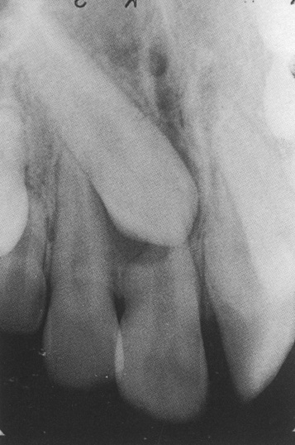
b) First premolar
I) Crowding of maxillary arch
II) Bimaxillary Protrusion
III) Class II Relation
c) Lateral incisor
Peg shaped or severely malformed lateral incisor(Dens
invaginatus) can be extracted instead of healthy premolars.
d) Central incisor
When there is advanced resorption of central
incisor roots more than 2\3rd and canine erupting
in a line close to the long axis of the incisor,
extraction of incisor is indicated.
These are the various methods in which space for guiding the impacted canine into position is obtained.

Slide 32
Attachments For canine
a) Ligature wire -- Jhonston
1) Poor control over direction of extrusion
2) Risk of external root resorption near CEJ
3) Risk of alveolar crestal bone loss and loss of attachment
epithelium
b) Bands -- Vonder heydt
1) Requires Extensive bone removal
c) cast canine caps -- Lewis,Dewel
1) Requires extensive crown preparation

Slide 33
d) Perforation of canine tips -- Fournier
1) Chances for non vitality of the tooth
2) Needs restoration of the tooth at the end of treatment
e) Direct Bonding -- Jacoby,Nielson
1) Easy to perform
2) More reliable method
Methodolgy of Approach
A) Early extraction of deciduous tooth:
When early extraction was performed due to caries,the immature tooth bud will be deep in the bone and unready for eruption.After healing permanent tooth felt difficulty in penetrating thickened mucosa.

Slide 34
Treatment: Removing fibrous mucosal covering and apically
repositioned flap was done , tooth will erupt spontaneously.
b) Retained decidious tooth:
Retained deciduous teeth is defined as tooth which is retained even after the permanent successors have reached the stage of development.
Treatment: Extraction of deciduous tooth.
Usally permanent successors are low in the alveolus, so after exposing the crown a periodontal pack is placed for 2-3 weeks.This will encourage epithelization down the socket and generally prevent the reformation of bone over the unerupted tooth.

Slide 35
C) Highly buccaly impacted canine:
These tooth are usually ankylosed and difficult to respond to orthodontic traction.
Treatment: Tooth should be luxated with extraction forceps such that it is not removed from the socket nor to tear the periodontal fibers.Accordingly this approach will be quite successful only if a continuous force is applied to the tooth from the time of subluxation.If the range of force is small and loses its potency between visit of adjustments,reankylosis will result.
D) Retained decidious tooth with deep infraosseus impacted canine:
These condition are difficult to manipulate.Usually tooth will be placed more than 17mm above the occlusal plane. So tooth have to take a long journey to come to occlusion.

Slide 36
Treatment: CRESCINI approached a method called as TUNNEL TRACTION.
Procedure:
a) Extract deciduous canine
b) Full thickness mucoperiosteal flap is elevated to expose the
cortical plate.
c) Drill with bur until exposing crown of canine
d) Tooth was bonded and ligature wire tied
e) Traction force given after 1week of surgery
Advantage:
a) No buccal or palatal access
b) No loss of supporting tissue
Disadvantage:
a) Post operative discomfort will be more.

Slide 37
Thus tooth can be guided in normal physiological eruption pattern through the crest of the ridge .
E) Palatally impacted canine:
When crown of canine is more palatally displaced,surgery on the buccal side needs to become more radical,rendering a palatal; approach preferable.
Usually palatally impacted tooth is guided to occlusion in two stages.
I) Guiding tooth to oral enviroment
II) Guiding tooth to line of arch

Slide 38
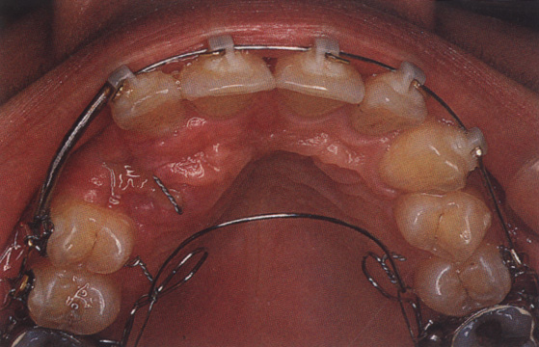
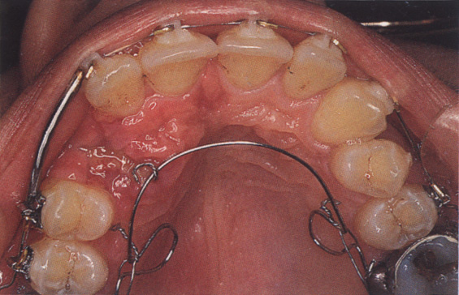
Guiding tooth to oral enviroment
I) Active palatal arch (Becker1978)
It consist of fine 0.020 inch removable palatal arch wire carrying an omega loop on each side. End of the wire is doubled for Frictionless fit in lingual sheath.It is activated by elevating downward activated palatal arch wire and hooking the pigtail ligature around it

Slide 39
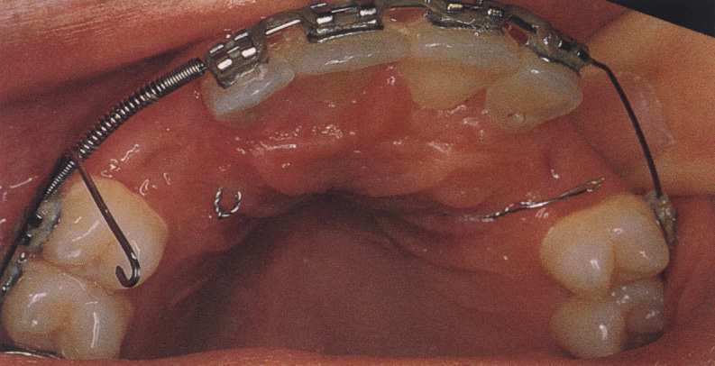
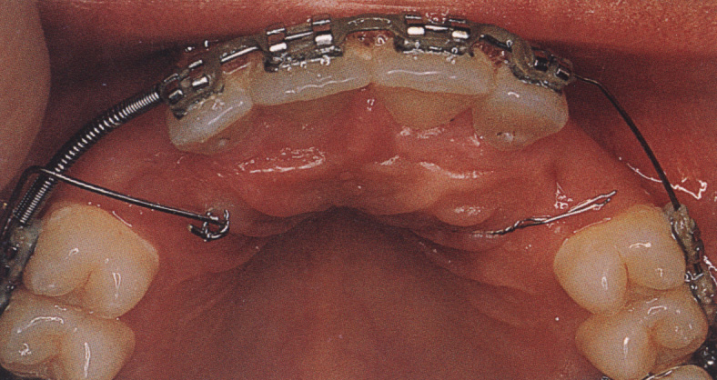
2) Ballista Spring (Jacoby 1979)
It is made of rectangular wires. It proceeds forward untill it is opposite to canine space and bent vertically downwards and terminate into a small loop.With slight finger pressure ,spring is tied to pigtail ligature. By this it provide an extrusive force for the canine to erupt.If the impacted tooth is resistant to movement or if the distance for the tooth to move is more it will leads to lingual molar root torque leads to loss of anchorage.To overcome this feature TPA is used.

Slide 40
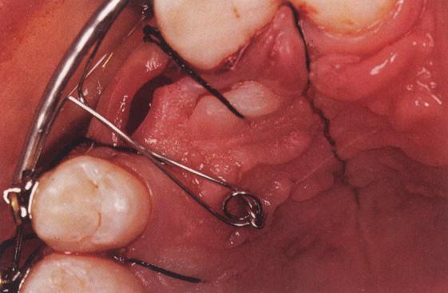
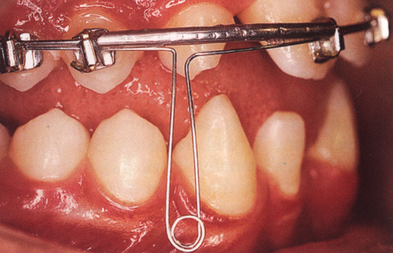
3) Light Auxiliary Labial Arch (Kornhauser1996)
It is made up of 0.014 inch round SS wire with vertical loops in the area of impacted canine on both sides.This loop has a small helix.This wire is tied with the basal arch wire in piggyback fashion.If basal arch wire is not used it will leads to extrusion of adjacent tooth and cause alteration of occlusal plane .

Slide 41
4) Mandibular removable appliance (Orton1996)
It consist of clasps through which elastic is applied from
clasp to the pigtail ligature wire. This provide the necessary extrusive force for the eruption of canine
For all the aforementioned methods the position of the attachment is immaterial and bonding is done on the most convenient surface available because no adverse rotation of tooth will occur while it is moving vertically downwards.
Guiding tooth to line of arch
Once the tooth is moved to the oral enviroment,bonding attachment is placed on the midbuccal aspect to prevent iatrogenic rotation of canine and guided to the line of arch.

Slide 42
a) If the root apex of canine is close to the line of arch and crown related to the roots of incisors,pure buccal tipping will bring the crown to desirable position and inclination.
b) If the root apex is distant to the line of arch and crown not related to the roots of the incisors,usually it will be impacted deep and may even crosses the mid palatal suture.These tooth can be directly guided to occlusion through labial arch wire since there is no inteference of roots of incisors.
c) If there is an horizontal impaction,downward tipping should be cautiously applied.Force application should be like the fulcrum of the canine to be at the root end ,so that root apex don’t alter following the canine tipping movement.

Slide 43
Unfortunately ,fulcrum is usually located short away from the apical portion of the root, leads to concomitant palatal displacement of root apex of canine. This requires buccal root torquing after alignment of canine in the arch.
d) If the root apex mesial to lateral incisor or distal to premolar , tooth is considered as TRANSPOSED.
I) Incomplete transposition: Roots will be in line of arch in its position and crown tipped due to path of eruption.(uprighting of tooth will align the tooth in arch).
II) Complete transposition: Both crown and root together will be completely interchanged.In these sutiation its better to align tooth to their respective position ,i.e canine between premolars or mesial to lateral incisors depends on type of transposition..

Slide 44
If we tried to align this tooth to their respective position,following will occur,
I) If canine is palatal to line of arch,secondary effect of root contact will rotate the root apex both mesially and palatally across the palate in a wide sweeping motion.the tooth will be laid down beneath the periosteum with huge dehiscence.
II) If canine is buccal to the line of arch ,secondary effect of root contact will cause further buccal displacement of root with gross dehiscence of buccal periodontium.
e) If canine is erupting in line of arch and in place of lateral incisors and resorbing the roots,canine should be guided in distal direction without extrusion in horizontal plane in a direct line towards the maxillary molars.

Slide 45
Once canine is moved away from the lateral incisor root, the resorption process stops completely.
If roots of lateral incisor is resorbed more than 2/3 rdit is more reasonable to remove incisor and to draw the canine down in to the place.
Surgical Exposure of impacted tooth
Circular incision or open approach :
This is done by removing mucosa over the crown to expose the impacted tooth.
Advantages:
a) Easy to perform
b) Suitable access can be provided for bonding of the attachment
c) Reduction of impaction is rapid.

Slide 46
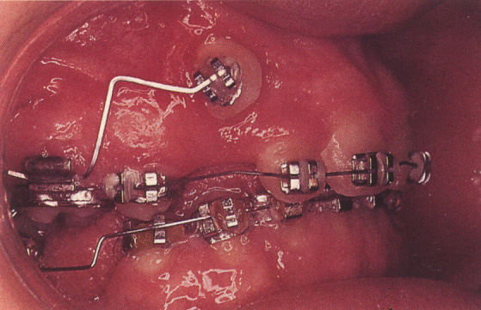
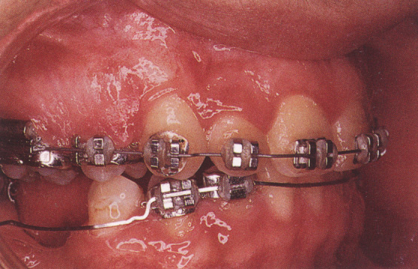
Disadvantages:
a) Tooth will be invested on labial side with thin oral mucosa rather than attached gingiva.
b)Typical soft tissue contour aggravates Plaque acclumation which leads to gingivitis.Inflammation will prevent regeneration of the Periodontal ligament which leads to apical movement of the epithelial attachment

Slide 47
Apically Repositioned Flap:
This method was proposed by Vanarsdall and corn in 1977.
Procedure:
In cases without deciduous canine, Mucoperiosteal flap is elevated from the crest of the ridge that includes attached gingiva.
In cases with deciduous canine ,tooth was extracted and the flap was designed to include the entire area of buccal gingival that invest it.
In either cases, Split thickness Flap is elevated by incision made vertically into the vestibule someway up into the sulcus,to expose the canine.
2/3rd of bone covering the crown was removed.
Connective tissue follicle was curreted from periphery of the exposed portion of the crown.

Slide 48
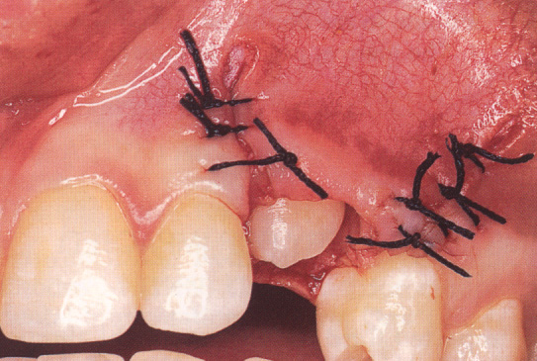
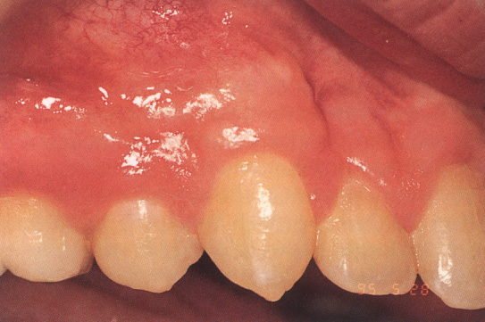
Flap is then sutured to the labial side of the crown of the permanent canine,to cover the denuded periosteum and overlying cervical portion of the crown.,while remainder portion of the crown is exposed.
Surgical dressing was placed on enamel to prevent overgrowth of adjacent tissue. Dressing was removed 1 week post operatively.After 2 weeks,orthodontic traction was started.

Slide 49
Advantages:
a) Maintain the width of attached gingiva
b) Easy access for bonding of the attachment
c) Tooth can be visualized from the time of exposure
still it come to occlusion
Disadvantages: Vermette 1995
a) Uneven and unesthetic gingival margin
b) Increased Clinical crown length
c) Some degree of attachment and bone loss on the
labial surface,which was considered as possibly related to an
increased potential for plaque accumulation.

Slide 50
d) Vertical orthodontic relapse:After apical repositioning
the gingival tissue heals to the adjacent mucosa, producing soft tissue band of gingival scarring. As the tooth is pulled incisally this mucosa get stretched down with it,toward the alveolar crest.Thus it tend to relapse once the force is released .
Full Flap Exposure:
This method was proposed by MCBride in 1979.This method is more effective for buccal and palatally impacted tooth.
Procedure:
A full buccal surgical flap is raised to expose the canine.An attachment is bonded to the tooth and the flap is sutured back to its former place itself.

Slide 51
Then a Twisted thread is tied to the bonded tooth and then drawn inferiorly and through the sutured ends of the replaced flap, or through the crest of the ridge or through the socket vacated by the extracted deciduous canine.
Advantages:
a) Tooth can be erupted towards and through the attached gingiva which maintains the width of the attached gingiva
b) No gingival scarring and good periodontal attachment is established
c) No vertical relapse
d) Conservative bone removal
e) Immediate traction possible
f) Less discomfort and good post operative Haemostasis

Slide 52
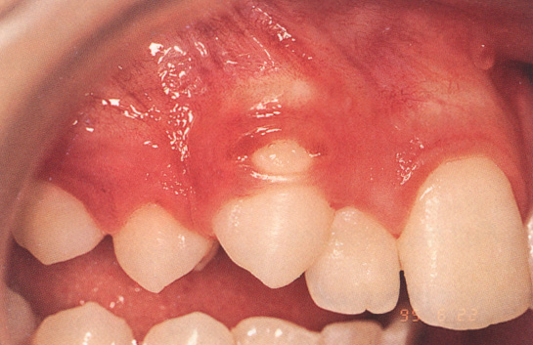
Disadvantage:
a) Placement of the bonding attachment is necessary at the time of exposure
b) If there is a bond failure it needs re-exposure
c) Difficulty in gaining dry field
d) Buttonholing: This occurs because of the buccal
prominence of the tooth, lack of buccal
bone and relative tightness of the
replaced flap.The damage to the
mucogingival tissue is due to the bulk
of wide and high profile conventional
bracket, which may leads to a breakdown of the overlying tissue to cause a dehiscence

Slide 53
Dentigerous Cyst:
Dentigerous cyst is a well defined radiolucent lesion of alveolar bone and inhibit the eruption of the involved tooth.
Treatment:
Marsupialization is the procedure consists of fenestrating the outer wall of the cyst, and relieving the intracystic pressure. With this early decompression, the size of the cavity slowly decreases, enabling the surrounding bone to regenerate around the impacted tooth, which eventually will erupt into the dental arch.
Thus Marsupialization has the advantage of reducing the cystic cavity and preserving the involved tooth.Average time to erupt after Marsupialization is 109 days,without any traction. Orthodontic traction is necessary if it delays later..

Slide 54
Hyomoto 2003 showed Tooth will erupt after marsupilazation only it fulfill the following criteria
1) Less than 2/3rd root formation.
2) Less than 80º to tooth axis angulation to occlusal plane
3) Less than 9mm deep in bone
Impacted tooth and Periodontium
In 1984 Becker showed Exposure of the crown should be sufficient to bond attachment rather than exposing upto CementoEnamelJunction.Previously for placing bands surgeons Deliberately and completely remove the follicle surrounding the tooth.When these tooth erupt in to occlusion,these tooth will have longer clinical crown and reduced alveolar height.

Slide 55
Kokich and Mathew showed that bone removal should not be more than 2/3rd of the impacted tooth crown.
Light orthodontic movement like tipping , extrusion, and rotation have less periodontal breakdown than Heavy orthodontic movement like root uprighting and torquing.
In 2002 Charles and Frank showed periodontal condition depends on the type of surgery.Closed approach seems to be preferable than open approach and apically repositioned flap.
Kokich showed Liquid etchants should not be used in the exposed surgical field, since it is difficult to prevent the spread to the exposed soft tissues,CEJ,tooth attachment area and bone surfaces.This will aggravates periodontal breakdown. So it is better to use GEL.

Slide 56
RETENTION
I) Rotation and spacing occurs in 17.4%. Fibrectomy and fixed bonded retainer is Preferable in most cases.
II) Clark 1985 showed Lingual drift can be prevented by removal of half moon shaped wedge of tissue from lingual aspect of canine which further improves retention
COMPLICATION OF UNTREATED IMPACTED CANINE
1) Crown Resorption:
With age reduced enamel epithelium surrounding the completed crown will degenerate and its integrity will lost.This leads to direct contact of bone and connective tissue with the crown and

Slide 57
osteolytic activity will leads to resorption of enamel and its replaced
by bone ,a process called Replacement Resorption. This is seen
specially in adult patients who left untreated 2-3 decade of age.
2) Labial or lingual malposition of impacted tooth
3 ) Migration of neighboring teeth and loss of arch length
4) Internal resorption of impacted tooth
5) Cyst formation {Dentigerous cyst}
Trauma or carious lesion of deciduous canine will
cause periapical pathology which may leads to direct interconnection
between apical pathology and Follicular sac surrounding the impacted
canine.If the follicular sac enlarges more than 2-3mm,it represents
cystic changes

Slide 58
Dentigerous cyst orginates after the crown of the tooth completely formed by acclumation of fluid between the reduced enamel epithelium and the tooth crown.
Dentigerous cyst may enlarges at the expenses of maxillary bone and displace canine higher in the maxilla.
Potential complication of dentigerous cyst
a) ameloblastoma
b) Epidermoid Carcinoma
c) MucoEpidermoid carcinoma
6) Resorption ofLateral incisor root:
This progress of undesirable phenomenon depends on eruptive movement of the impacted canine. If the impacted tooth is removed or redirected the resorption process usually ceases.

Slide 59
TIME TO EXTRACT CANINE
1. Ankylosed and cant be transplanted.
2. External and internal root resorption
3. Dilacerated root
4. If impaction is severe such that canine lodges between the roots of central and lateral incisors and the orthodontic movement will Jeopardizes adjacent teeth.
5. Occlusion is acceptable with 1st premolar in canine place.
6. If any severe pathologic changes {Cyst,Infection}
7. If patient does not desire orthodontic

Slide 60
Conclusion:
Thus management of the impacted canine is one of the greatest challenge for orthodontist. Success of the treatment depends upon patient cooperation, Age of patient, Proper diagnosis, Level of canine impaction, Inclination and Depth of impaction, Amount of root formation, Type of exposure of tooth, Amount of bone removal, Type of attachment, Orthodontic traction. All these parameter plays important role when managing impacted canines to achieve good canine alignment in the arch with canine guided occlusion, Gingival level, and Integrity of periodontium.

Slide 61
Thanks

