Slide 1
Development of
Dentition stage of tooth development

Slide 2
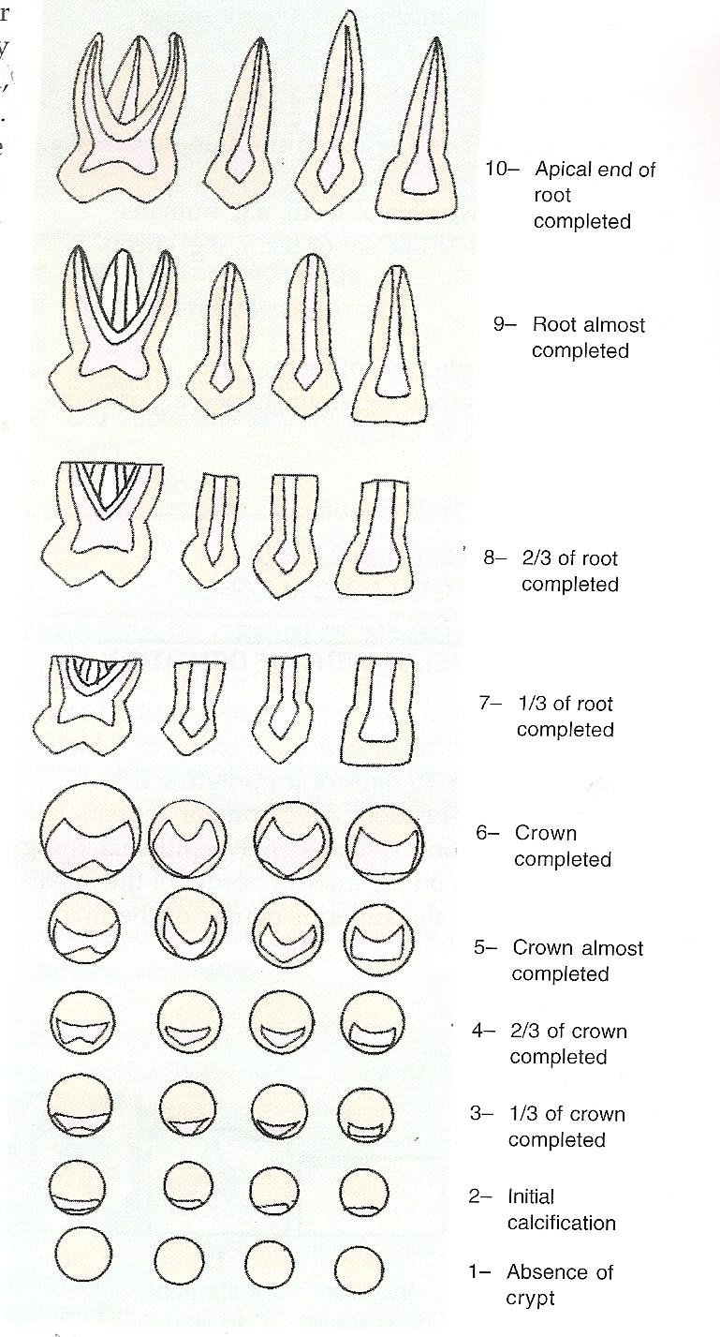
Nolla (1952) divided tooth development into various stages.
He took the calcification of crown and root into account

Slide 3
STAGES OF DENTAL DEVELOPMENT
Pre dental period
The deciduous dentition period
The mixed dentition period
The permanent dentition period

Slide 4
PRE DENTAL PERIOD
Lasts for 6 months after Birth
Gum pads:-The alveolar arches of an infant at the time of birth are called gum pads. They are pink in color and firm in consistency of and recovered by dense layer of fibrous periosteum.
Upper gum pad is horse shoe shaped while lower is ‘U’ shaped and rectangular.
Gum pads are greatly thickened oral mucous membranes of the gum which soon become segmented and each segment is a developing tooth site.
The pads get divided into labial/ buccal and a lingual portion. These are separated from each other by a groove called the dental groove.

Slide 5
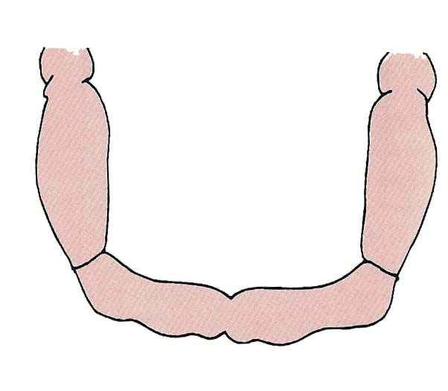
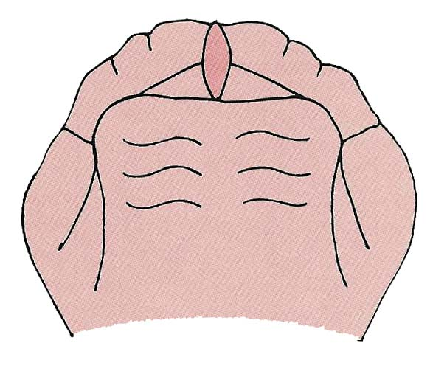
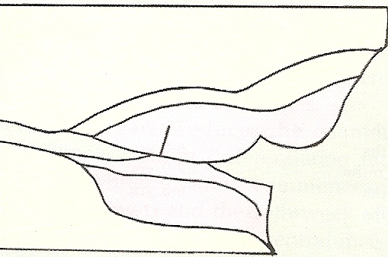
MAXILLARY GUM PAD
MANDIBULAR GUM PAD
Relation between upper and lower gum pads at birth

Slide 6
Transverse grooves divide gum pads into 10 segment each segment consists of one developing deciduous tooth sac.
Gingival groove separates the gum pads from the palate and floor of the mouth.
Transverse groove of the canine and first deciduous molar segment is called lateral sulcus which is useful in judging inter arch relation ship at very early stage.
Lateral sulcus of mandibular arch is normally more distal to that of maxillary arch.

Slide 7
RELATIONSHIP OF GUM PADS
Anterior open bite is seen at rest which contacts only in the molar region, tongue protrudes anteriorly through this space. This is considered normal and it helps in suckling
Complete over jet all around
Class II pattern with max gum pad is more prominent.

Slide 8
THE STATUS OF DENTITION
Neonate is without teeth for about 6 month at birth gum pads are not sufficiently wide to accommodate developing incisors which are crowded In their crypts during 1st year of life they grow rapidly permitting incisors to erupt.
Natal teeth which are present at birth.
Neo natal teeth which erupt during 1st month of age.
Natal teeth are present at birth incidence in 1:1000
Pre erupted teeth erupt during the second or third month.
Natal and neonatal teeth are almost always mandibular incisors which frequently display enamel hypoplasia and have familial tendency.

Slide 9
THE DECIDUOUS
DENTITION PERIOD
This stage starts from eruption of the first deciduous tooth (usually mandibular central incisors ) and ends with the eruption of the first permanent molar i.e. from 6 months to 6 years of post natal life.
By 2.5 year to 3.5 year of age when the second deciduous molar come into occlusion, the deciduous dentition is completed.
Eruption age & sequence of deciduous dentition

Slide 10
CHRONOLOGY OF HUMAN PRIMARY DENTITION
Tooth Eruption Root Completed
maxillary
Central incisor 71/2 mos 11/2 yrs
Lateral incisor 9mos 2yrs
Cuspid 18mos 31/2yrs
First molar 14 mos 21/2yrs
Second molar 24mos 3yrs

Slide 11
MANDIBULAR
Central incisor 6mos 11/2yrs
Lateral incisor 7mos 11/2yrs
Cuspid 16mos 31/4yrs
First molar 12mos 21/4yrs
Second molar 20mos 3yrs
A variation of 3 month from the mean age has been accepted as normal
Sequence of eruption is:-A-B-D-C-E

Slide 12
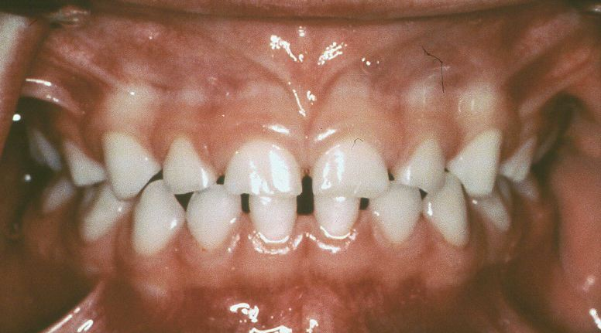
NORMAL SIGNS OF
PRIMARY DENTITION
  Spaced anterior :- spacing usually exists between deciduous teeth these spaces are called physiological or developmental spaces. They accommodate the larger permanent teeth in the jaws.

Slide 13
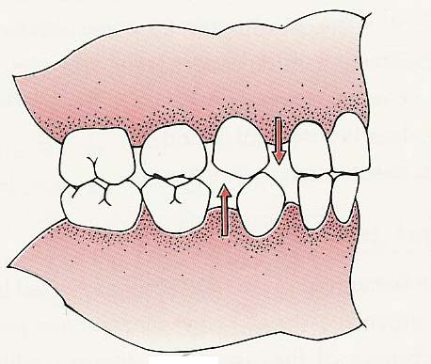
Spacing invariably is seen mesial to the maxillary canines and distal to the mandibular canines. These physiological spaces are called primate spaces seen commonly in primates. They help in inter digitations of opposing canines and used for early mesial shift.
PRIMATE SPACES/SIMIAN
SPACES/ANTHROPOID SPACES

Slide 14
  FLUSH TERMINAL PLANE
  When the distal surfaces of maxillary and mandibular deciduous see and molars are in the same vertical plane, this is the normal motor relationship in the primary dentition because the M-D width of mandibular molar is greater than M-D width of maxillary molar.

Slide 15
DEEP BITE
This is due to more upright position of deciduous incisor then their successor.
This deep bite later reduced due to following factors-
Eruption of deciduous molar
Attrition of incisors
Forward movement of mandible during growth

Slide 16
THE MIXED DENTITION PERIOD
Period where teeth of both deciduous and permanent dentition are seen.
it extends from 6 to 12 year of age. Most malocclusions make then appearance during this stage.
This stage can be divided into three transitional periods
First transitional period
Inter transitional period
Second transitional period

Slide 17
FIRST TRANSITIONAL PERIOD
This stage is characterized by
  emergence of the first permanent molars
  transition of incisors.

Slide 18
Eruption of permanent first molars
1st permanent molars erupt at 6 years.
Its location and relationship depends upon terminal plane relationship between upper and lower deciduous second molar which can be of three types –
Occlusal relationship between primary & permanent molar

Slide 19
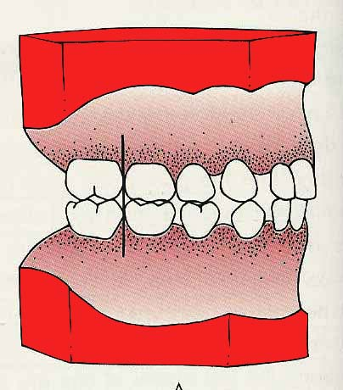
Flush/Vertical Terminal plane
when distal surfaces of upper and lower deciduous second molars are in one plane.
the permanent 1st molar erupts initially into a cusp to cusp or and on relationship which later transforms into a class I by moving the lower molars 3 to 5 mm in relation to upper molar -either by utilization physiologic spaces/leeway spaces.
-or by differential forward growth of mandible.
FLUSH TERMINAL
PLANE

Slide 20
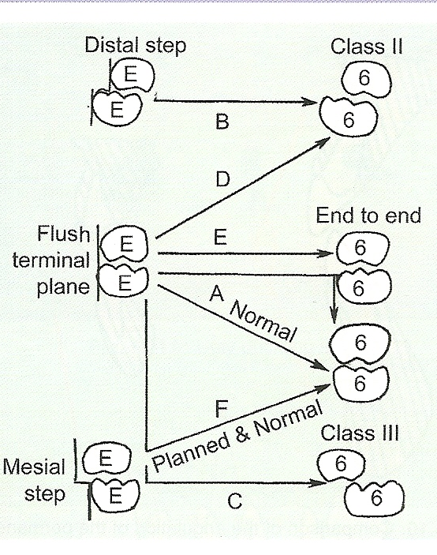
Early shift -molar shift using the primate spaces late shift -This is brought about by mesial shift of the permanent first molar following exfoliation of the primary molar and this making use of leeway space.

Slide 21
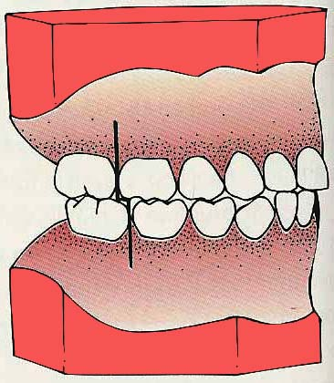
MESIAL STEP
Distal surface of mandibular deciduous 2nd molar is mesial to the distal surface of maxillary deciduous 2nd molar.
MESIAL STEP TERMINAL
PLANE
In this relationship permanent molars erupt directly into Angle’s class I occlusion

Slide 22
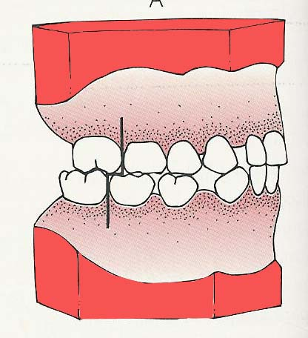
DISTAL STEP
distal surface of mandibular deciduous 2nd molar is more distal than the distal surface of max. deciduous second molar
Erupting molars may be in Angle’s class II occlusion.
DISTAL STEP TERMINAL
PLANE

Slide 23
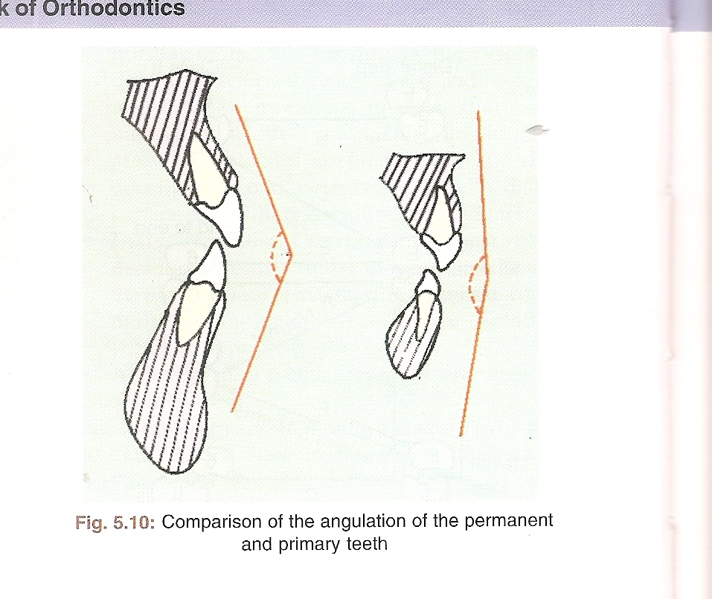
The exchange of incisors
Incisal liability -The deciduous incisors are replaced by the permanent incisors, permanent are larger than deciduous the difference between the amount of space need for the accommodation of the incisors and amount of the space available for this is called Incisal liability.
It is 7.6 mm in maxilla and 6 mm in mandible.
This space is provided by -
Comparison of Angulation of Permanent & Primary Teeth

Slide 24
Utilization of Inter dental physiologic spaces in the primary incisor region - 4 mm in maxillary arch, 3 mm in mandibular arch.
Increase in the intercanine arch width : significant amount of growth occurs with the eruption of incisors and canines.
Change in position Permanent incisors erupt labial to the primary incisors to obtain and added space of 2-3 mm.
Change in incisor inclination Primary teeth are upright but permanent teeth incline to the labial surface thus decreasing the inter incisal angle from about 150° in the deciduous dentition to 123° in the permanent dentition. This increases arch perimeter

Slide 25
INTER TRANSITIONAL PERIOD
(1.5 YEARS)
This is a stable phase where little changes takes place. Teeth present are permanent incisors and first molar along with deciduous canines and molars.
Other features of this stage :-
Any asymmetry in emergence and corresponding differences in height levels of crown lengths between right and left teeth are made up.
Ugly duckling stage

Slide 26
Root form of emerged incisors, canines and molars continue along with concomitant increase in alveolar process height.
Resorption of roots of deciduous molars

Slide 27
THE BROAD BENT’S PHENOMENON
UGLY DUCKLING STAGE (8-10) YEARS
Crowns of canines n young jaws impinge on the development of lateral incisor roots thus driving the roots medially and causing the crowns to flare laterally.
Roots of central incisors are also forced together thus causing max.
midline diastema.
The period from the eruption of lateral incisors to canine is termed as ugly duckling stage.
It occurs around the 8 years age and commonly seen in upper arch
It is an unaesthetic metamorphosis which eventually leads to an aesthetic result.

Slide 28
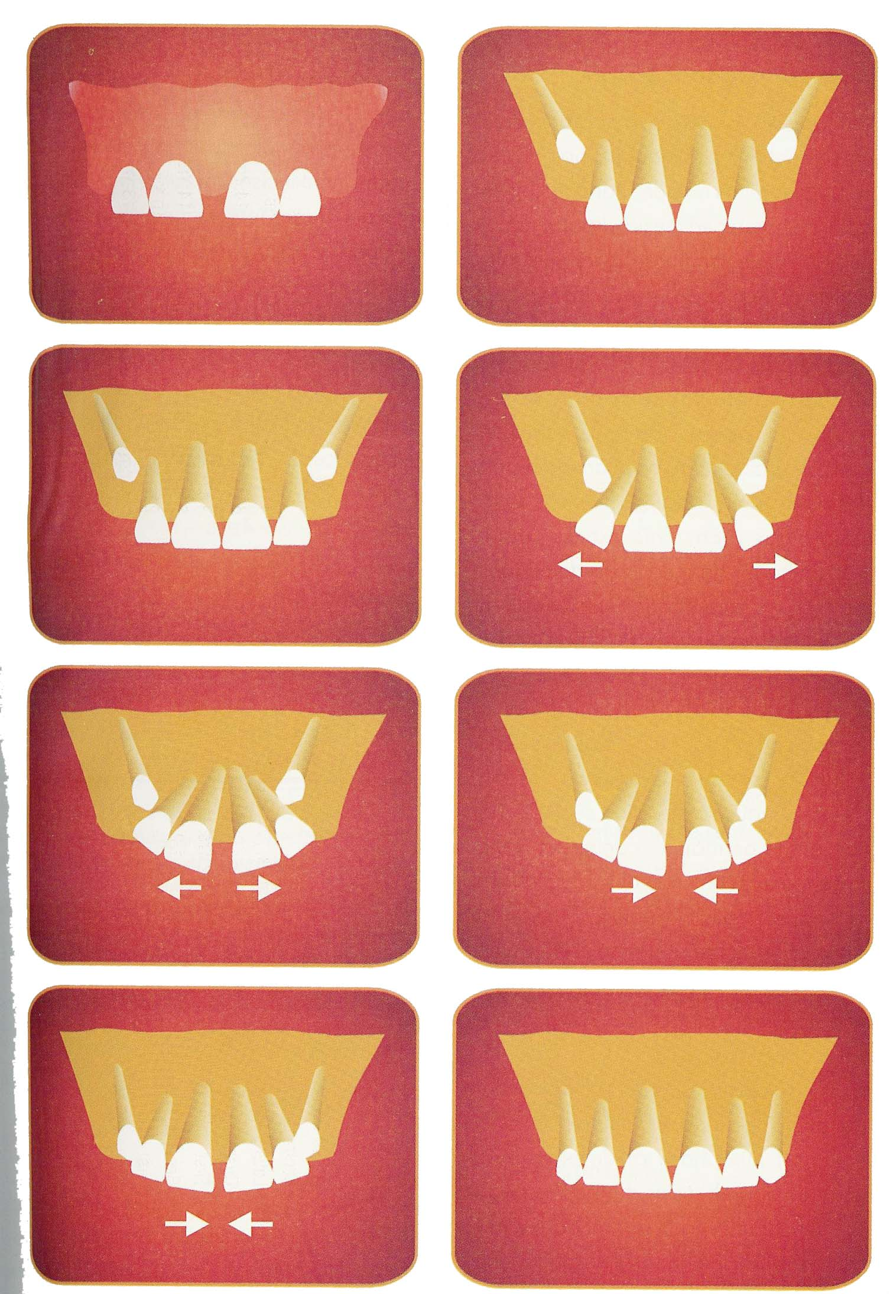

Slide 29
SECOND TRANSITIONAL PHASE
It is characterized by the replacement of the deciduous molars and canines by the premolars and permanent cuspids respectively
The combined mesio-distal width of permanent canines and premolars in usually less than that of deciduous canines and molars the surplus space n called leeway space of Nance. Amount of space is -
0.9 mm/segment in max. - 1.8mm total
1.7mm/segment in mandible;-3.4 mm total

Slide 30
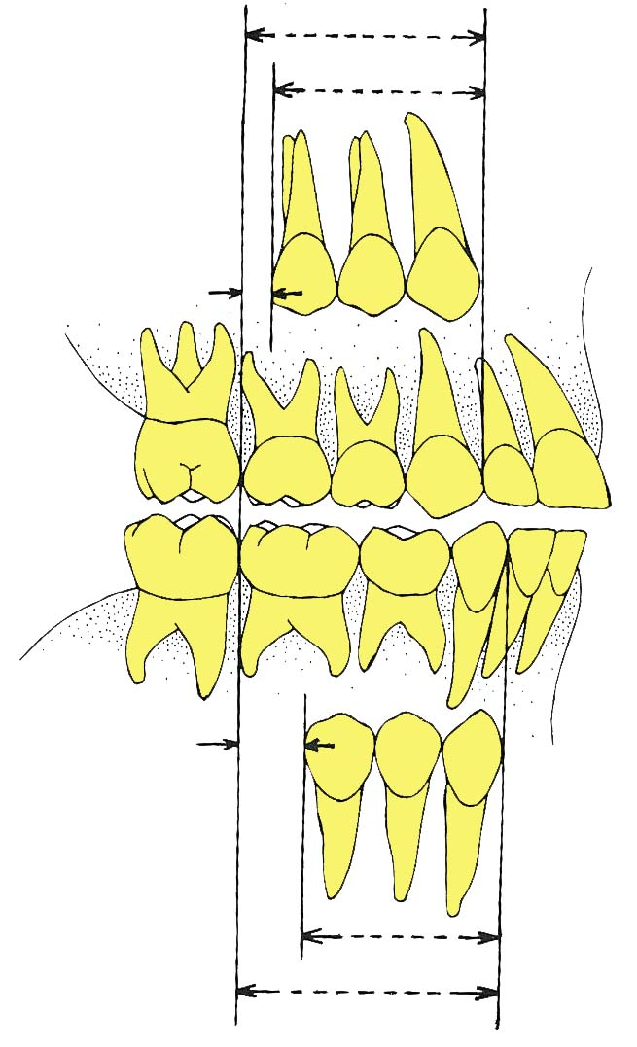

Slide 31
CLINICAL CONSIDERATION
When there is delayed ruption of an. autimerk beyond the 6-months period the clinician should carefully examine the patient to exclude the presence of any pathologic conditions as a cyst or a supernumerary tooth.
The "balance test" is used to determine if maxillary labial frenum extends lignually the central incisors toward the incisive papilla. The test is performed by pulling on the upper lip superiorly and outward. If blanching extends to the incisive papilla, it might indicate the presence of an abnormal frenum attachment.

Slide 32
THE PERMANENT DENTTION
The permanent dentition forms within the jaws soon after birth calcification begins at birth with the calcification of the cusps of the first permanent molar and extends as late as the 25th year of life. Complete calcification of incisor crowns takes place by 4to 5 years and of the other permanent teeth by 6to8 years except for the third molars. Therefore the total calcification period is about 10 years. The permanent incisors develop lingual to the deciduous incisors and move labials as they erupt. The premolars develop below the diverging roots of the deciduous molars.

Slide 33
At approximately 13 years of age all permanent teeth except third molars are fully erupted. Before the deciduous incisors are shed, there are 48 teeth/parts of teeth present in the jaws.
Features of the permanent dentition:
Co-inciding midline.
Class I molar relationship of the permanent first molar.
Vertical overbite of about one third the clinical crown height of the mandibular central incisors.
Overjet : over jet and over bite decrease throughout the second decade of life due to greater forward growth of the mandible.
Curve of spee : develops during transition and stabilizes in adulthood.

Slide 34
SEQUENCE OF ERUPTION
There is wide variability in the sequence of arrival of teeth in the mouth.
Maxilla 6-1-2-4-3-5-7-or 6-1-2-4-5-3-7 (most common)
Mandible 6-1-2-4-5-3-7 or 6-1-2-3-4-5-7(most common)

Slide 35
CHRONOLOGY OF HUMAN PERMANENT DENTITION
Tooth Eruption Root Completed
Maxillary
Central incisor 7-8 yrs 10yrs
Lateral incisor 8-9 yrs 11yrs
Cuspids 11-12yrs 13-15yrs
First bicuspid 10-11yrs 12-13yrs
Second bicuspid 10-12yrs 12-14yrs
First molar 6-7yrs 9-10yrs
Second molar 12-13yrs 14-16yrs

Slide 36
Mandibular
Central incisor 6-7yrs 9yrs
Lateral incisor 7-8 yrs 10yrs
Cuspid 9-10yrs 12-14yrs
First bicuspid 10-12yrs 12-13yrs
Second bicuspid 11-12yrs 13-14yrs
First molar 6-7yrs 9-10yrs
Second molar 11-13yrs 14-15yrs

Slide 37
CLINICAL CONSIDERATION
Tooth size arch length discrepancies TS(D) significantly increase from early adolescence (3 yrs of age) until early adultchered (25 years) when the changes in the anterior TSALD between 13 & 45 years were calculated the total mandibular arch maxillary arch change amounted to 2.7 mm & 19 mm respectively in male subjects & 3.5 and 20 mm in females sub yeasts. As a result one may speculate that without longterm retention adolescents who were lorthodontically treated to a perfectly alighted dentition should expect some crowding to occur in the anterior part of the of the dental arches. Clearly these findings have imp clinical implications regarding the long term stability and retention of the results.

Slide 38
CONCLUSION
Development of dentition in humans is complex and depends on many variables. Development of dentition deviates markedly from that of other parts and structures of the body. Crowns of teeth are formed directly to adult size and housed within the jaws years before they emerge.
To determine an abnormal course of development, it is the responsibility of an orthodontist to have adequate knowledge on the subject to differentiate abnormal from normal before initiating therapy.

Slide 39
THANK YOU

